Slide 1

IoT BASED AUTOMATIC BELL SYSTEM WITH MOBILE APPLICATION
S. KATHEESKUMAR
BAT/IT/2018/FT/030

Slide 2
INTRODUCTION
A bell is a percussion instrument used in schools and colleges.
This design takes over the task of ringing the bell in various institutions.
The bell would ring automatically at the schedule time.
The bell would control by using smart phone.

Slide 3
OBJECTIVES
To create a fully automated and user-friendly bell systems that can be operated through via smartphones at schools
To maintain an effective time management through the punctual bell system
To access every function of the bell system through smartphone effectively

Slide 4
BLOCK DIAGRAM
RTC
ESP8266
MICRO
CONTROLLER
EEPROM
POWER SUPPLY
OLED DISPLAY
RELAY
ELECTRIC
BELL
AC 220 – 240 V

Slide 5
ARCHITECTURE DESIGN
Wi-Fi
CORE
SYSTEM
HTTP
SERVER
DB
SMART PHONE
AUTOMATIC BELL SYSTEM

Slide 6
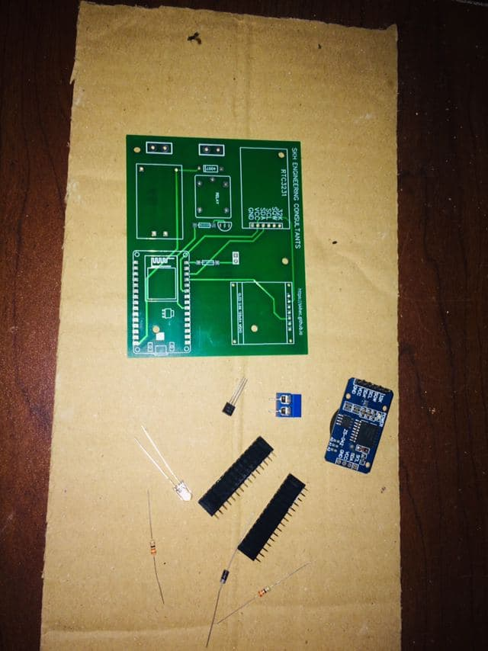
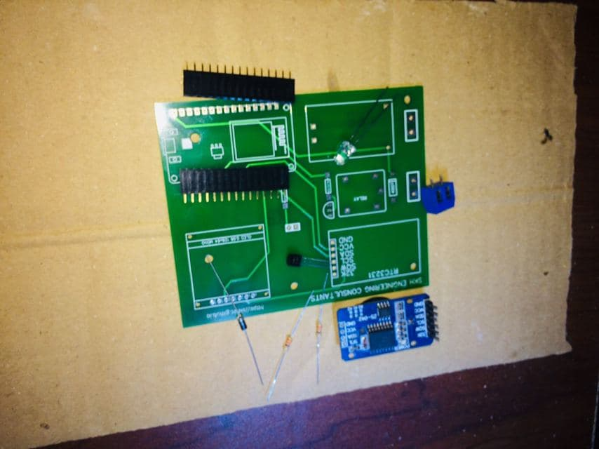
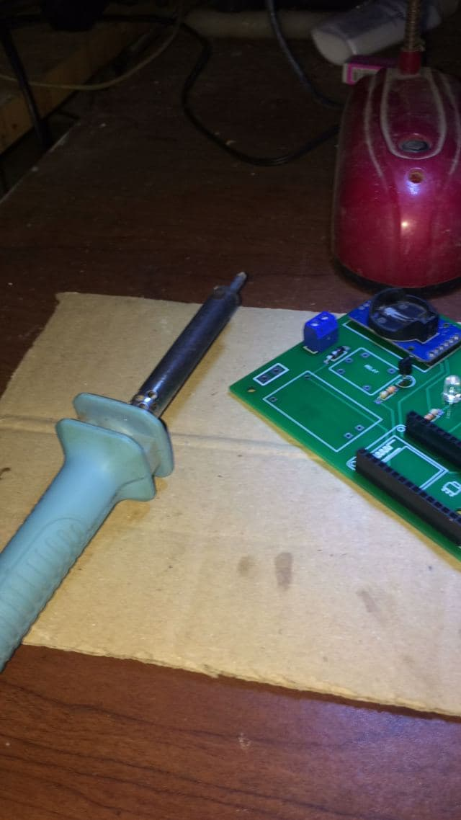
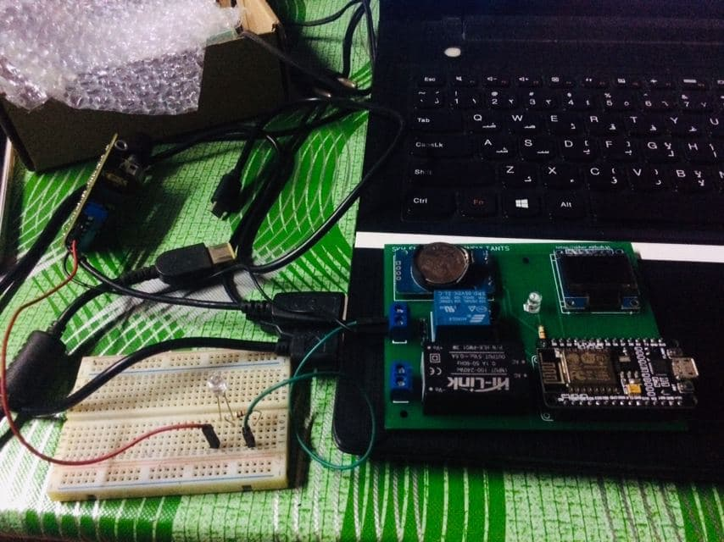
HARDWARE DESIGN

Slide 7
ADVANTAGES
This project can be used in educational institutes, colleges, schools.
This project can also be used in industries.
It is an automatic system.
Human errors can be avoided.
Safety is assured

Slide 8
QUESTIONS
?

Slide 9
THANK YOU

